Slide 1
Using Machine Learning to Classify Car Brands
Team 4:
Atharva Datar
Eric Geerts
Varun Sampat
Vineet Kaushik
Notes:
Hello everyone, welcome to team 4’s presentation …
Applications/relevance:
CCTV
Self driving car
Ecommerce.

Slide 2
Relevance

Slide 3
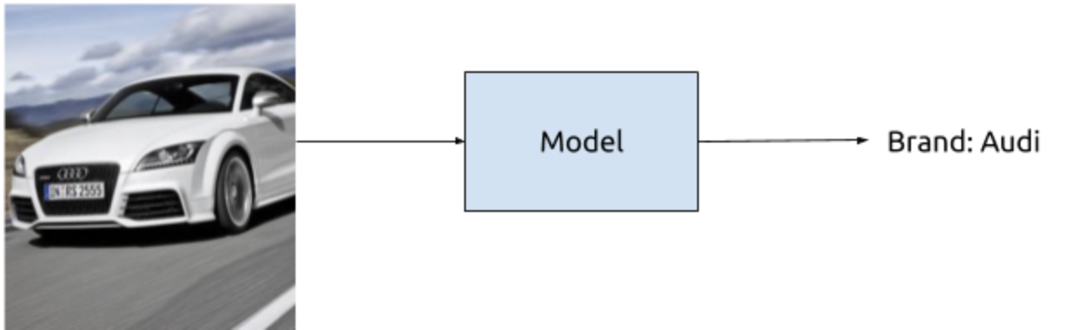
Define the problem
East or West
ML is the Best!
Notes:
Seems like a simple enough, doesn’t it? However, one must remember that there are over 50 major car brands in the world today and for us to accurately classify the images we would need a large dataset.

Slide 4
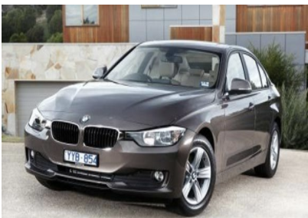
How did we get the data?
Stanford University has a ‘Cars Dataset’, with models upto 2012
Contains around 16,000 images for 196 classes
Each class is defined as “Brand name + Model + Model year”
Label: 2012 BMW M3 coupe
Notes:
Which is why after careful consideration, we decided to chose the Stanford University car dataset. It has over 16,000 images of cars classified into 196 classes. Each class is defined by the brand name, the model as well as the model year. However, for the purpose of our problem we decided to classify the images by just their brand.

Slide 5


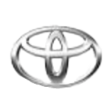
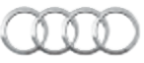
Why brand name?
On average each class (brand + model + model-year) has 80 images
If we take a 50:10:40 split, each class (brand + model + model-year) gets only 40:10:30 images per train:valid:test.
There are 50 distinct brands, splitting based on brands would give more images per class (only brand) to work with.
Notes:
So why did we make this decision? It’s simple math! Since each class had only 80 images, after splitting up the dataset we would have a very limited number of images to train the model. So splitting the data based only on the brand would give us more data to work with leading to a better model!

Slide 6
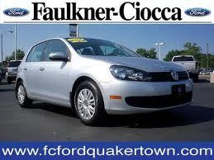
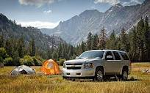
Other limitations of the data
There is a lot of noise present in the given dataset, such as different backgrounds, people, text and other features
Hence, this problem is not as straightforward as it seems, especially as a machine learning image classification problem
Notes:
Some limitations of the dataset include the presence of text in images as seen in the first example. In the first example we can also see the presence of two Ford logos, whereas the car is actually a volkswagen. As seen in the second example, the car may not always be the subject of the image. Such background noise, makes the problem harder than it seems, especially while using machine learning for classifying images.
The images given in the data set are not that straightforward
The brand is “Volkswagen” but the image contains the brand logo of “Ford”
Similarly, this brand is Chevrolet, but the picture’s scenic background dominates more

Slide 7
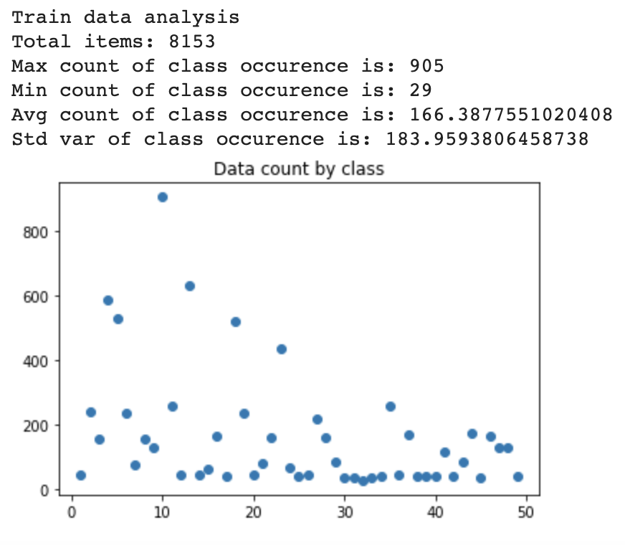
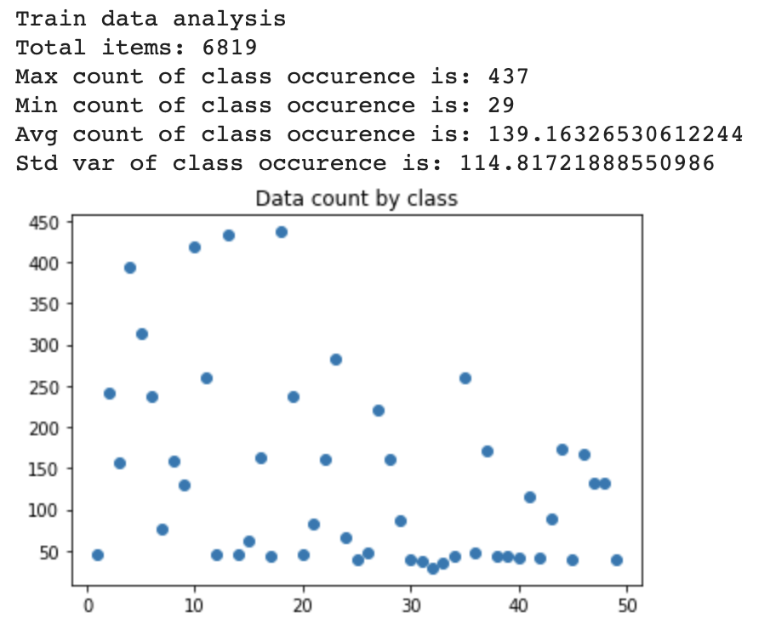
Data processing
As mentioned before, the number of classes were reduced from 196 to 50
Data analysis on the original dataset
Data analysis on the modified dataset
Notes:
Previously mentioned, we reduced the number of classes. We did that using a descriptor file that contained the class names for all original labels. To reduce the classes, unique brand names were extracted from that file and stored in a data structure.
This change impacted the even count distribution of our data, as seen on the left. There were many ways to tackle this new issue. The first alternative was to duplicate images for all low count classes.Another alternative was to get rid of images of classes with high count.
First, we removed images of high count classes, as there were fewer classes with high counts as you can see on the diagram. Making that adjustment resulted in a distribution as seen on the right. We did not duplicate images of low counts as the first change resulted in a good performance overall, which will be discussed later on.

Slide 8
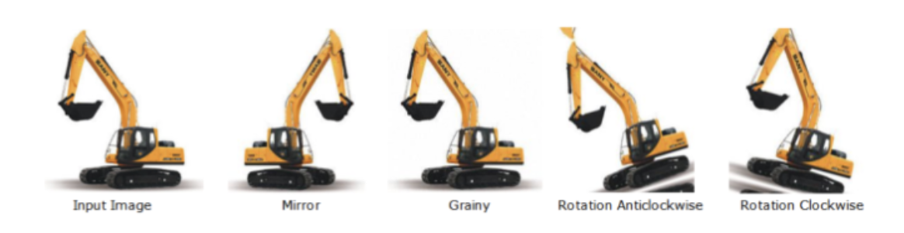
Data Augmentation
Color invariance
Flipping the image
Rotating in both directions by a small angle
Notes:
The following manipulations had to be done to the training data to make the model more robust to noise. These changes do not affect the car brand, which is why they were taken up as a method to remove noise.

Slide 9
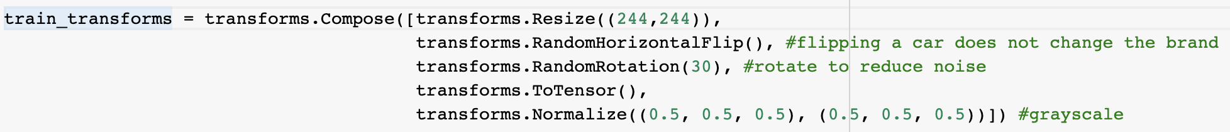
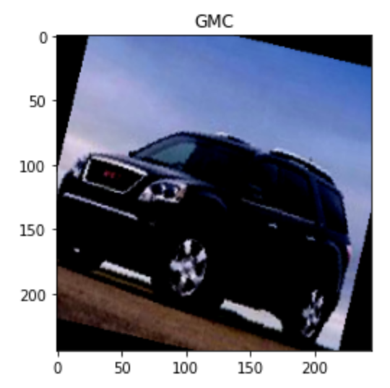
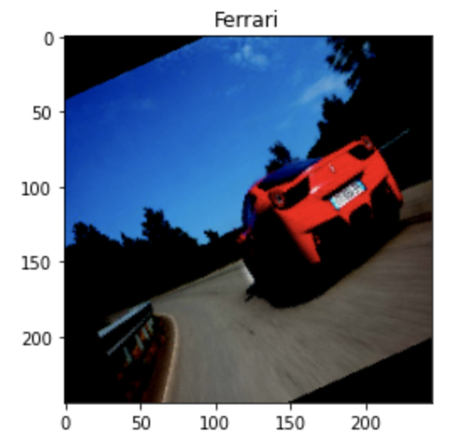
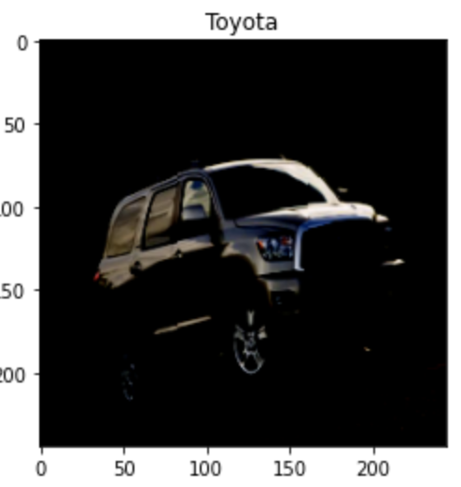
Data Augmentation
Notes:
-incorporating these. The manipulation as discussed previous were integrated in the transforms object as seen in the code above. The result transformation is seen in the images below, which has removed a lot of noise, rotated the images randomly. The images are not completely black & white, but still better than the original dataset

Slide 10
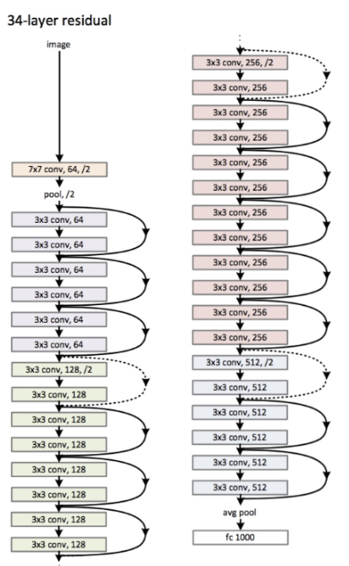
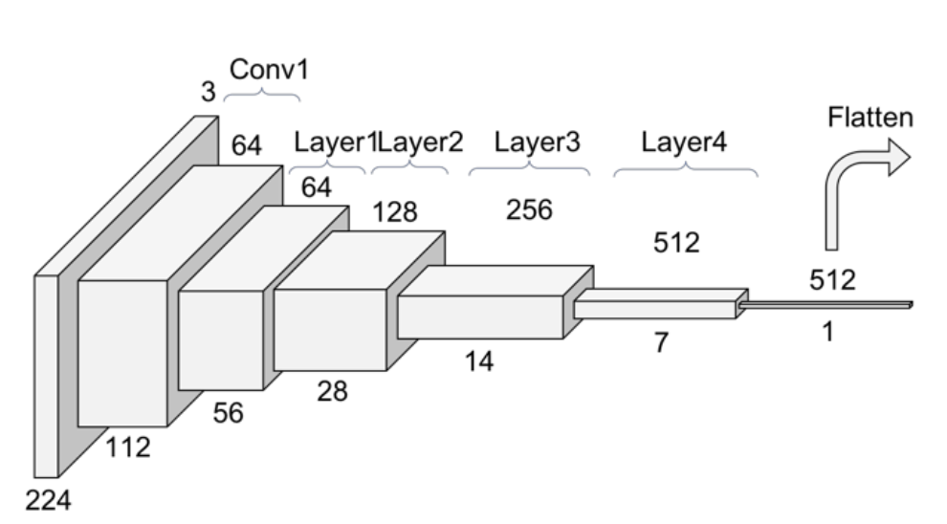
Model
Pretrained ResNet34 model
34 convolution layers, split into 4 sequential layers
One fully connected layer with 512 inputs

Slide 11
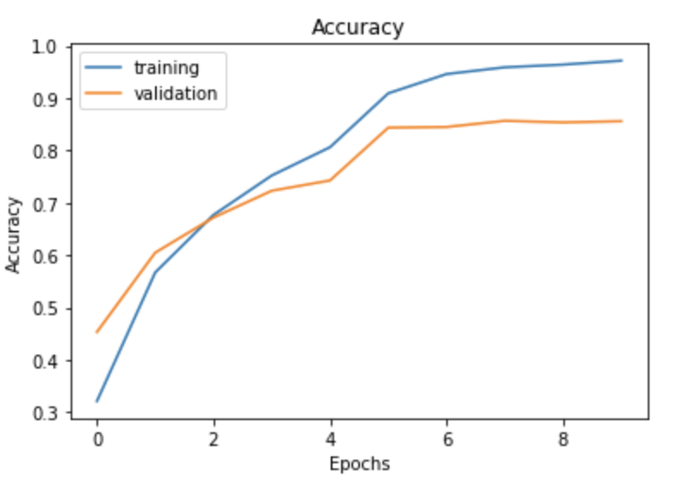
Hyperparameter tuning!
Model 1- batch_size = 512, num_epochs = 10, learn_rate = 0.001; Val accuracy = 0.81
Model 2- batch_size = 128, num_epochs = 10, learn_rate = 0.001); Val accuracy = 0.82
Model 3- batch_size=64, num_epochs=10, learn_rate = 0.001; Val accuracy = 0.825
Model4- batch_size=32, num_epochs=10, learn_rate = 0.001; Val accuracy = 0.833
Model 5- batch_size=32, num_epochs=10, learn_rate = 0.01; Val accuracy= 0.856
Final Model: Model 5- batch_size=32, num_epochs=10, learn_rate = 0.01

Slide 12
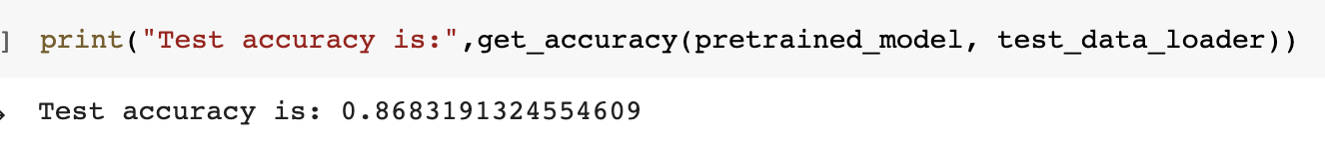
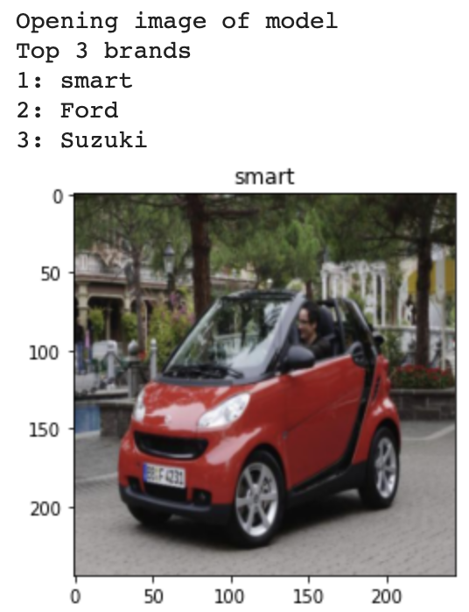
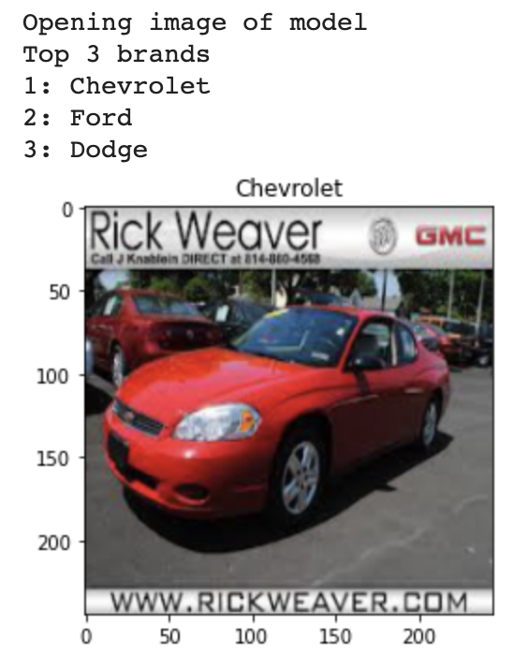
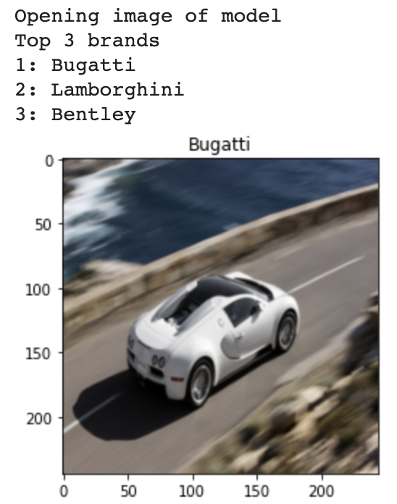
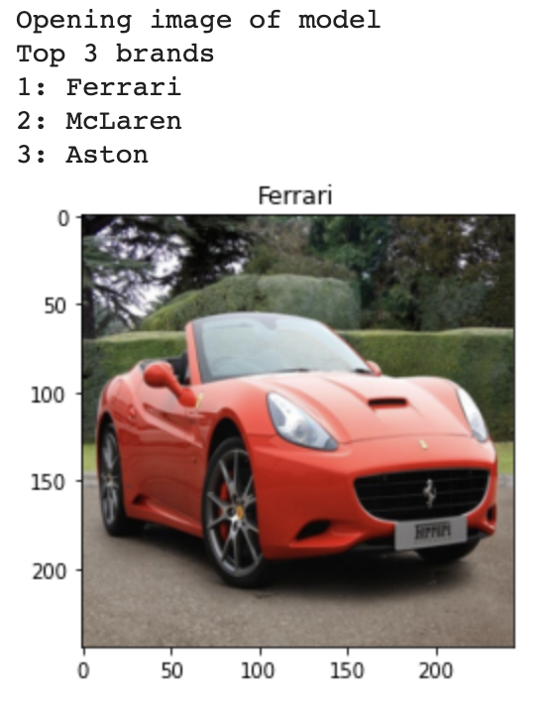
Results & Discussion
Results of images taken from the test data set:
Correct
Correct
Correct
Correct
Notes:
The results of our model were truly promising. Our final model obtained an accuracy of 97%, 86% and 87% for training, validation and testing respectively. A few images taken from different classes and were fed to the model. The 4 images seen show the model’s top 3 predictions. Notice carefully, how the model has also picked up features/traits across similar models. For example, in Bugatti’s & Ferrari’s prediction, the other brands that the model thought were possible outputs were McLaren, Aston Martin, Lamborghini and Bentley. These brands are also into manufacturing spots/luxury cars.

Slide 13
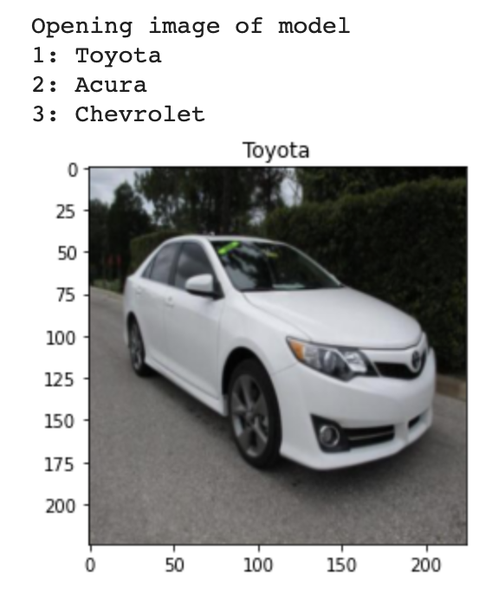
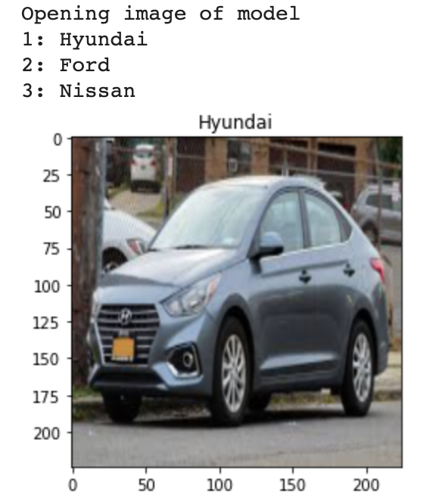
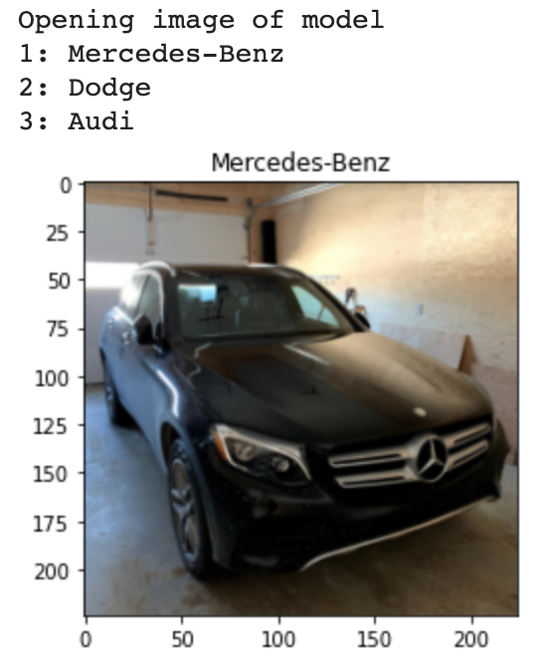
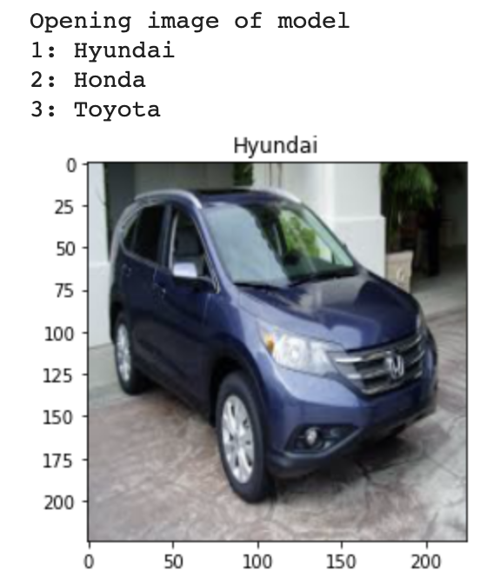
Live Demonstration & further discussion
The images on the right are taken by us (2020), from the streets of more recent models of brands in the data set
Correct
Correct
Correct
Incorrect
Notes:
In the previous slide, the images were taken from the testing data set, which included models upto 2012. For the live demonstration and for further discussion, let’s see how the neural network behaves when it is given more recent models from brands it saw in the data set. These pictures were taken by us from either the streets or from google images.
The model correctly classified 7/8 images, out of which 4 are shown here. Of the incorrect classification, which is on the bottom right on the screen, the correct classification, which is Honda, was missed marginally. Nonetheless, it is very impressive that our neural network predicted correctly across time as companies keep changing the designs of their cars. Unfortunately, since this is not a live presentation, we could not show this demonstration live. But we would love if you got in touch with us after the presentation, sent us pictures of cars you would like to see tested and then show you the results!

Slide 14
Further discussion
Car models used in the demonstration were not actually in the data set. They were either newer versions of models in the dataset, or just models that were not in the dataset. Still, 3 out of the 4 pictures were correctly classified. This means the model was able to learn about the

Slide 15
Takeaways
What did you learn about machine learning?

Slide 16
Thank you for your time!
Team 4
References:
The movie clip used in this video was from ‘The Fate of the Furious’. All copyrights are owned by the respective producers.
Stanford data set: 3D Object Representations for Fine-Grained Categorization.Jonathan Krause, Michael Stark, Jia Deng, Li Fei-Fei. 4th IEEE Workshop on 3D Representation and Recognition, at ICCV 2013 (3dRR-13). Sydney, Australia. Dec. 8, 2013.

Slide 17
Thank you!

